Slide 1
Luruuli/Lunyara
Zarina Molochieva
Lexical Data Master Class
4-6 Dec, Berlin

Slide 2
Challenges
Turning Toolbox format into online publication
Morphology in the dictionary
Dealing with examples in the dictionary

Slide 4
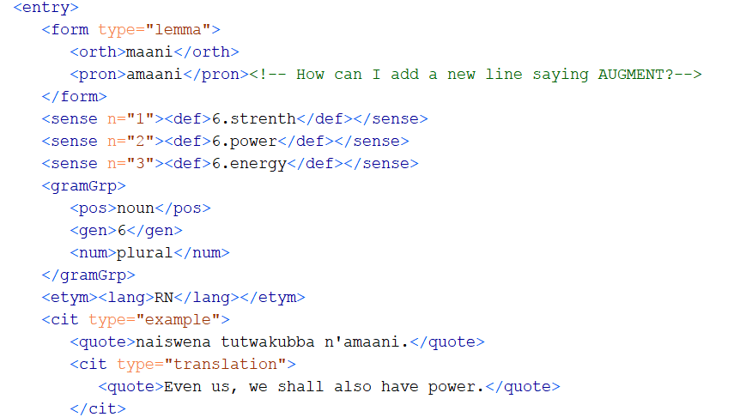
Noun

Slide 5
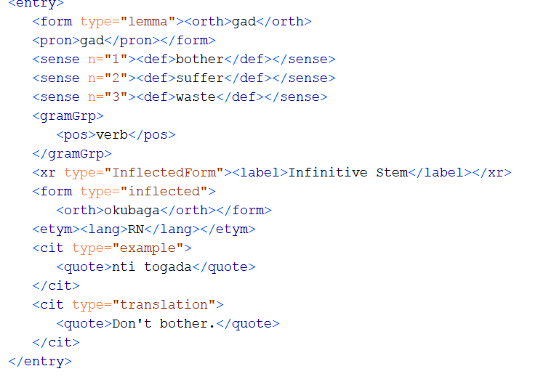
Verb

Slide 6
